Slide 1
Nest retirement income blueprint

Slide 2
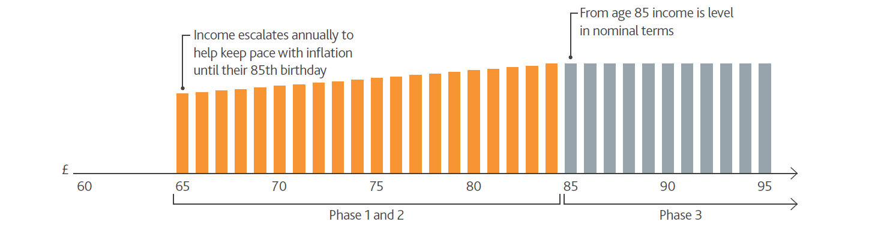
Nest’s retirement income strategy – what a member would see
Nest sets an income level for members that is designed to last throughout retirement
Phase 1: Mid-to-late 60s to mid 70s
Phase 2: Mid 70s to mid 80s
Phase 3: Mid 80s onwards

Slide 3
Under the bonnet design – flexible lifelong income
Flexible income account
Rainy day fund
Monthly payments
Buy later life income
Later life protected income
Flexibility
Securing the future
Security for life

Slide 4
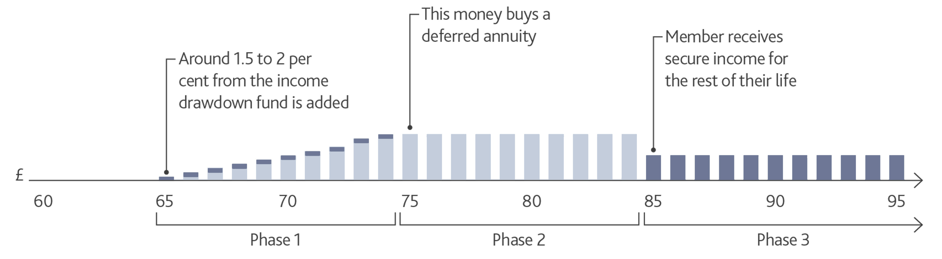
Securing a later life income
Later-life protected income fund

Slide 5
© Nest Corporation 2024. All rights reserved.
This information does not constitute financial, investment or professional advice and should not be relied on.
We do not make any personal recommendation or give advice to employers and their workers or third parties on how to make investment decisions. If you are considering using Nest you should consider talking to an appropriately qualified professional.
We do not give any undertaking or make any representation or warranty that this document is complete or error free. We do not accept responsibility for any loss caused as a result of any error, inaccuracy or incompleteness.
Any form of reproduction of all or any part of these slides is not allowed.

